Slide 1
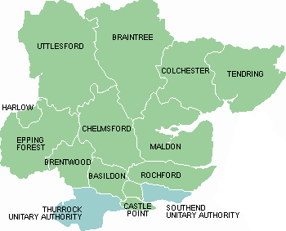
Essex Primary Headteachers’ meetings
Education Directorate
LA Input
11th November 2021
Mid Quadrant
“Excellence, Equity, Inclusion.”

Slide 2
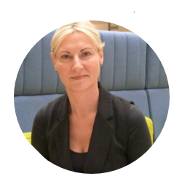

Essex Strategic Priorities 2021/22
Director’s welcome
Education Task Force
SEND update
ECC resettlement of refugees
In-Year (Mid-Year) Admissions from April 22
Safeguarding
Early Years Strategy
School Partnership refresh and relaunch
Assessment and Moderation

Slide 3
ECC Education - Strategic Aims 2021 - 2022
Drive collaboration, partnership working and collective improvement across the Education, Health and Care system. | So that a connected system can achieve more significant, sustainable improvements utilising all of our collective assets, resources, skills and innovation for the benefit of all children and young people.
Encourage place-based working, understanding the needs, challenges and opportunities of different localities of Essex. | So that we can respond effectively, make best use of resources and encourage all relevant partners in those localities to work effectively together around the needs of young people. Including forging links with local employers and post 16 opportunities to support economic growth and lead to Essex jobs for the young people of Essex.
Align our workforce, strategies, communication and information across our directorate, behind one clear vision and overarching strategy. | So that our business and service plans enable achievement of our vision for Education in Essex with a workforce who is well equipped and supported to achieve the very best outcomes for children and young people in Essex.
Support, drive and enable whole school/setting inclusive practice, underpinned by our early intervention and non-labelling approach | So that all children and young people have access to high quality, inclusive learning experiences, with timely intervention to remove barriers and build aspiration.
Deliver sufficient, high quality, sustainable education places for all Essex children and young people, underpinned by a network of school partnerships accelerating school improvement. | So that every child and young person has a place in a ‘good’ or outstanding’ school which delivers high quality learning experiences, attainment and retention of skills and knowledge and enables successful transition into adult life.
Enable Essex to have a thriving education workforce with access to informal and formal professional learning opportunities and wellbeing support initiatives. | So that the delivery of high-quality teaching and learning can be sustained and our best talent nurtured and retained within Essex for the benefit of children and young people.

Slide 4
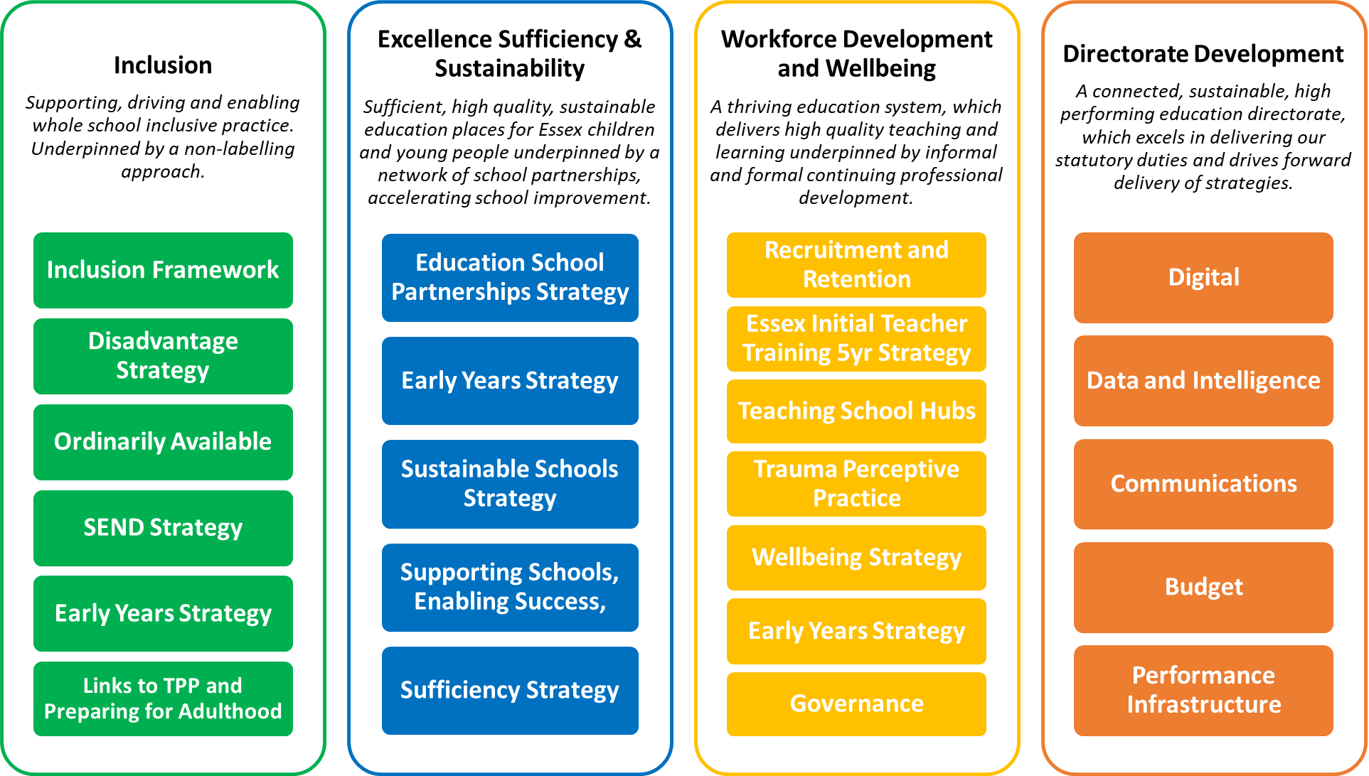

Slide 5
Our core work for this year will include:
  Working with all settings, schools and MATs to ensure the highest quality of education is provided to all children and young people and inclusion is at the heart of all of our work.
  Working with Roy Blatchford and the Essex Education Taskforce on the delivery of the activities the Taskforce has put together including the ‘2022 Year of Reading’.
  A continued focus on our SEND improvement journey in response to the Local Area SEND inspection and subsequent Joint Written Statement of Action
  Work continues on the development of an Ordinarily Available Framework and joint commissioning of services as well as improvements to the Local Offer, Preparing for Adulthood resources, Early Years support and resources to support accurate identification of need.
  Linked to and as part of this work, we will continue to roll out across schools, settings and colleges Trauma Perceptive Practice, the Disadvantaged Strategy and continue to pilot the Inclusion Framework.
  We will also continue to work with the Headteacher Roundtable to develop a suite of tools and expectations to ensure every school can be as inclusive as possible for all pupils and students.
  We will continue to promote the safety and emotional wellbeing of all children and young people across Essex.
  We will respond to the new requirements placed on the Virtual School to promote high educational outcomes for both children in care but also children in need.
  Provide support to Cllr Ball and the cross-party working group that has been established to review the Elective Home Education / Children Missing Education system in Essex.
  And finally, we will continue to prioritise the Headteacher Wellbeing programme across primary, secondary and special schools.
Notes:
We acknowledge that all of our teams contribute to these objectives in one way or another – what will help them to see themselves and their roles in this? E.g. principles or our ways of working.

Slide 6
Essex Education Taskforce

Slide 7

What we have done so far?
National view activities regarding ‘recovery’ in Education
Independent chair appointed
Board established – have met 3 times
Agreed what is going to be achieved

Slide 8
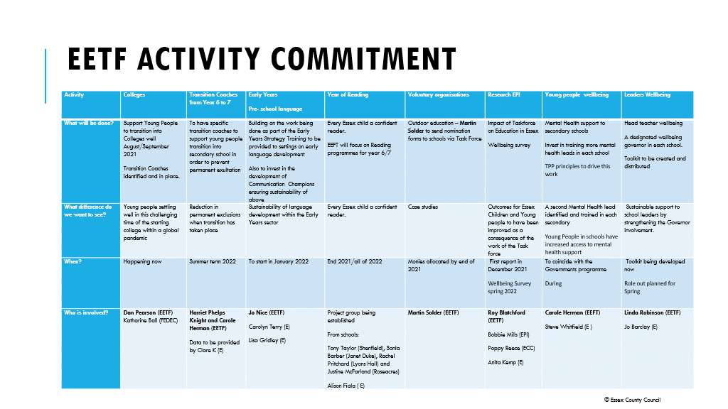

Slide 9
The Year of Reading 2022
Lots of enthusiasm about what this could do
Also many opinions
Working group being established on 10 November
Focus for Task Force is reading in Year 6 and 7 – schools have seconded senior leaders to develop this
No surprise! Many things going on already – mapping commenced
BUT
What can we do with what we have to support the Year of Reading for Children in Care, SEND and other vulnerable children?

Slide 10
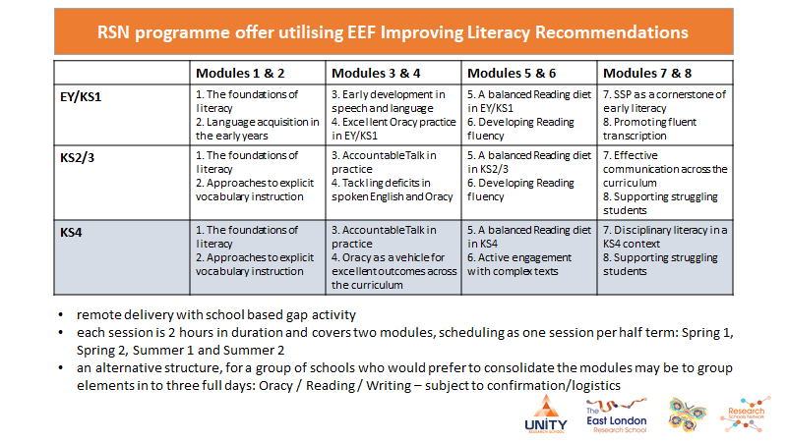

Research School Network offer
Notes:
Cost - £120 per person, 2 hours per module. Likely to be 2pm to 4pm to support with capacity. Suitable for all staff responsible for developing literacy and language across a key stage or wider. It is preferential that participants are involved in shaping policy and practice, linked to teacher development.
Starting Spring 1.

Slide 11
SEND Update

Slide 12
Joint Written Statement of Action
Workstream | Workstream Lead | High Level Actions
1. Quality of EHCPs | Clare Kershaw – Director of Education (ECC) | End to end process review and re-engineering to deliver improved EHCP processes (including annual review) Develop options for new processes Review funding options Implement practices to drive improvement in quality of plans (including training, multi agency moderation, quality assurance)
2. Over identification of MLD/ Accurate Identification of Need | Ralph Holloway – Head of SEND Strategy & Innovation (ECC) | Understand the scale and reason for over-identification of MLD Deliver training, support, guidance and resources to improve identification of need across the system Develop and deliver guidance around recording of CYP needs on the census Implement process to highlight and respond if data deviates from expected
3. Joint Commissioning | Richard Watson - Deputy Chief Executive / Director Strategy and Transformation (NECCG) Chris Martin – Director Of Commissioning & Policy (ECC) | Develop SEND Joint Commissioning Strategy Develop SEND joint data set Undertake mapping and gap analysis of services across the local area Jointly commission services around: ASD/ADHD Therapies: Speech and Language, Physio and OT Equipment SENDIASS Local Offer

Slide 13
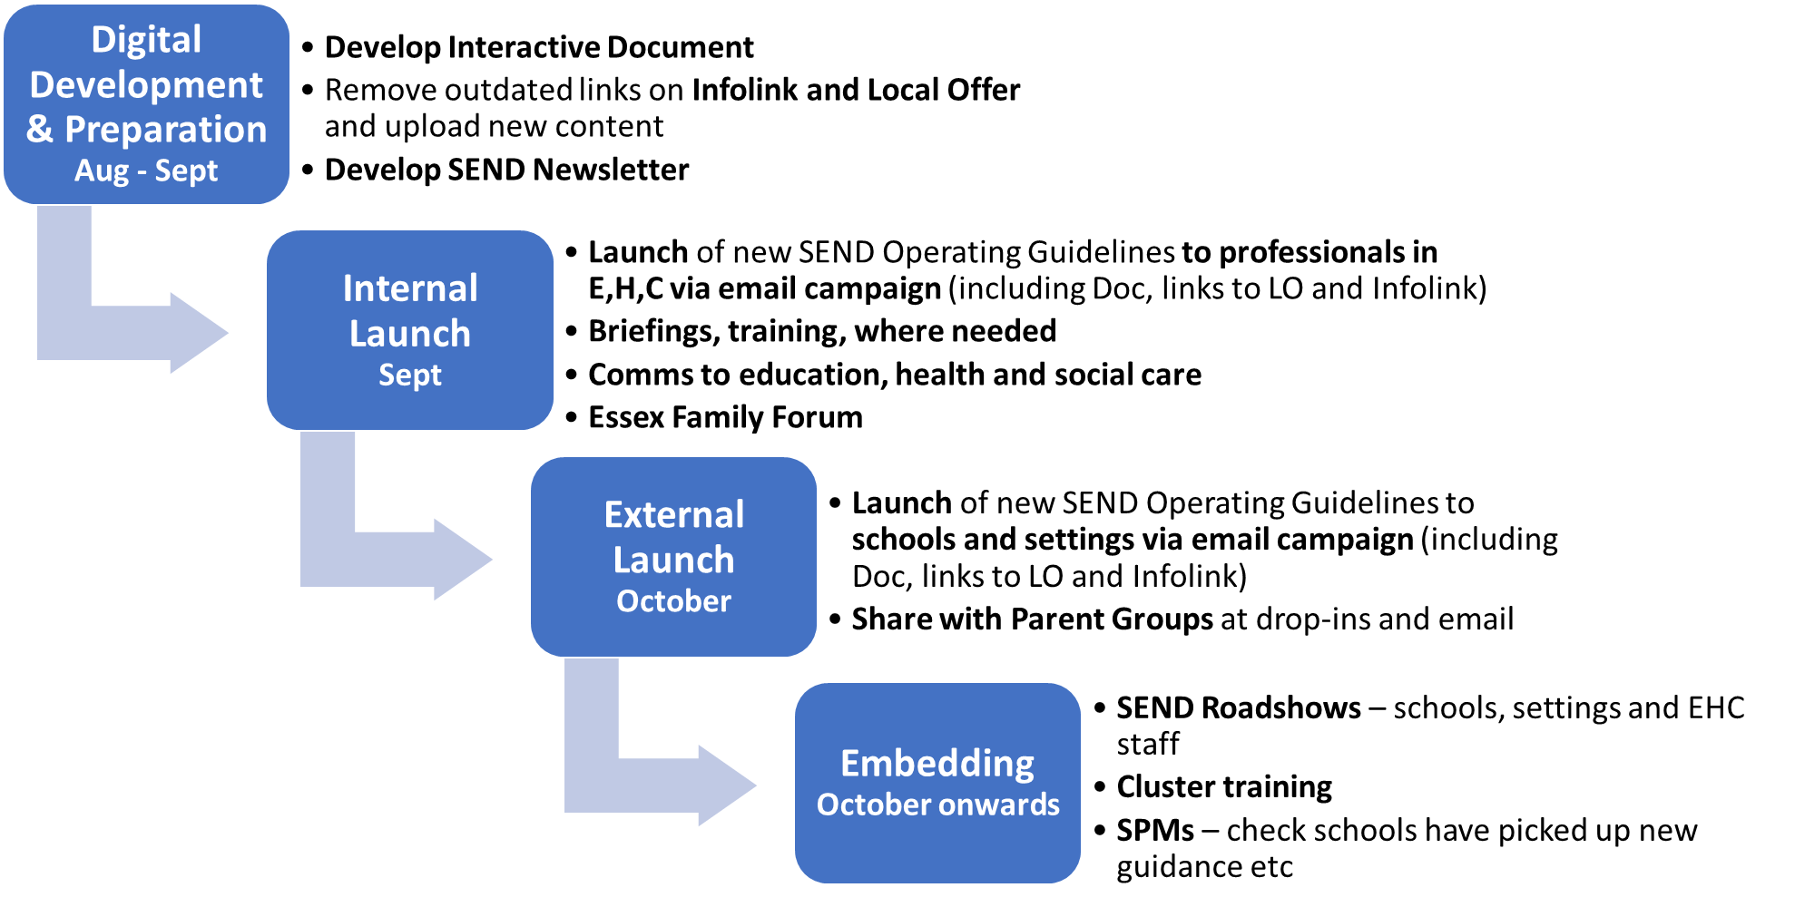
High Level Implementation Plan
The below outlines the implementation approach and timescales for the initial set of outputs in the Autumn term. We will keep the approach under review and take the same/ similar approach for future outputs, which will be released in January.

Slide 14
SEND Strategy
Overview
A local area strategy that sets out our vision, aims and ambitions for the SEND System in Essex, how we will achieve them and how we will measure our success.
Timescales
Consultation
March 2019
Further discovery work throughout 2020
Draft strategy content
June – Sept ‘21
Design work
September ‘21
Launch
Late Autumn Term
The strategy includes:
Purpose/ Introduction
Our Pledge
Vision for SEND in Essex
Governance
October ‘21
The strategy test
Actions
Outcomes
Success measures

Slide 15




SEND Strategy
Coming soon

Slide 16
LA Updates

Slide 17
Afghan resettlement efforts and unaccompanied asylum seeking
Councils are working closely with central government on resettling evacuees from Afghanistan, securing longer term accommodation options.
The DfE report approx. 300 children and young people have been transferred since the summer, with 4 in 5 LAs taking at least one child.
Children’s services teams across the country are supporting a very small number of young evacuees who are unaccompanied.
The government has confirmed additional funding to facilitate new school enrolments as well as additional support in the classroom.
DfE reported that the MoD is working with the Home Office on a detailed census of everyone accommodated in bridging hotels (expected to complete by mid-October).
This data will then inform funding, £12 million has already been committed to the creation of additional school places as part of ‘Operation Warm Welcome’
ADCS reported safeguarding concerns are beginning to emerge requiring a different response than originally anticipated e.g. the rising numbers of children who travelled here with another family coming forward.
The HO is offering increased rates to agency social workers in the south east to undertake age assessment work. This risks destabilising children’s services. It is unclear how these social workers are being supervised and regulated.

Slide 18
In-Year (Mid-Year) Admissions from 1 April 2022
From 1 April 2022, parents will need to apply directly to own admission authority (i.e. academy, foundation and voluntary aided) infant, junior and primary schools for an in-year (mid-year place).
  Parents will still apply to the LA for community and voluntary controlled schools
  The change in no way affects the normal admission rounds for starting Reception for the first time, or infant to junior (Year 2- 3) transfer
  All these applications will still be handled by the LA Template application form and example offer and refusal letters, along with a process map, sent out by Shamsun Noor by email on 2 November 2021
  Further briefings will be arranged via EPHA for the spring term 2022
  Any queries in the meanwhile can be directed to Shamsun Noor at shamsun.noor@essex.gov.uk

Slide 19
Safeguarding

Slide 20
General update – key documents
Keeping Children Safe in Education (DfE, 2021)
Sexual violence and sexual harassment between children in schools and colleges (DfE, 2021)
Inspecting safeguarding in early years, education and skills (Ofsted, 2021)
ESI / Understanding and Supporting Behaviour
Positive environments where children can flourish (Ofsted 2018)

Slide 21
Updated materials for 2021-22
Level 2 training presentations
Model Child Protection Policy
Confirmation of Child Protection Documents Received
Safeguarding information for visitors to school
These videos from Children and Families may be useful to complement staff training:
Welcome to the Children and Families Hub - YouTube
Request for Support guidance for professionals - YouTube
The Windscreen of Need - Essex Children and Families Hub - YouTube

Slide 22
The Education and Learning Information Sharing Protocol
The information sharing protocol:
A protocol to support ECC and education providers to deliver services
It supports sharing that is safe, lawful and secure
It helps organisations meet their legal Accountability and Transparency obligations
It sets out the statutory and current practice sharing between education providers
ESI / WEISP

Slide 23
Harmful sexual behaviour – peer on peer abuse
further training for secondary settings (Spring 2022)
training for primary settings (Spring 2022)
training for governors (Spring 2022)
updated model HSB Policy
updated HSB checklist / audit
HSB guidance
Support with Relationships Education, Relationships and Sex Education (RSE) and Health Education (DfE, 2019) curriculum delivery

Slide 24
Other ‘bits’
ESCB audit – completion date is end of Spring Term
Prevent training – 6th December
Updated Understanding and Supporting Behaviour
Safeguarding / Alternative Provision guidance

Slide 25
Early Years Strategy
Carolyn Terry
EYCC Sufficiency and Sustainability Manager

Slide 26

Early Years and Childcare Strategy 2022 Update

Slide 27


Background
The previous Early Years and Childcare Strategy (EY&CC) 2015–2018 set out the specific commissioning and operational approach that delivered the strategic direction for the Authority, and the Council’s early years and childcare statutory duties in working with children aged from 0 to 19 and key partners such as health, local councils, voluntary sector, early years settings and schools.
As part of the initial Discovery phase for the new strategy, the project team undertook an;
  Analysis of the Essex Good Level of Development (GLD) data.
  Initial engagement with schools, early years settings and parents.
  Initial review of the impact of Covid-19.
  Horizon scanning.
  A series of workshops with key ECC staff
A draft of the new EY&CC Strategy 2022 has been developed with all key stakeholders during stakeholder engagement sessions and is currently going through ECC’s Governance to approve launching in January 2022.

Slide 28
Develop
Apr 21 – Aug 21
Governance
Aug - Dec 2021
Launch
Jan 22
Deliver
Jan 22 – Jan 27
Timeline and Key Deliverables
Share Strategy with Internal and External Stakeholders
Develop Strategy following feedback from Stakeholders
Develop Outcomes and Performance Measures
Comms & Go Live Plan
Draft Delivery Plan
Draft School Readiness Definition
Draft Early Years Charter
Project Governance - EY&CC Strategy Contents signed off
Strategy designed and finalised in an external facing document
Finalise Delivery Plan
Launch Strategy
Launch The Early Years Charter
Engagement sessions with Key Stakeholders for Strategy Launch and Delivery Plan
Pilot new ideas
Realise Outcomes and Measure Success

Slide 29
Impact of Covid on the Early Years Sector and Families
Numerous complexities emerge when we consider the implications of the pandemic and the diverse range of experiences faced by the early years sector, families and children.
Early indicators are showing that some Children are experiencing
  Separation Anxiety
  Delayed speech and language
  Struggling to form friendship group with peers
  Delay in support and assessment ie for children with SEND
  Stressful family situations, including Increased poverty
Early indicators are showing that some Parents are experiencing
  Increased poverty
  Stressful family situations
  Mental health issues
Early indicators are showing that some settings are experiencing
  Financial pressures
  Increased pressures in supporting anxious parents, children showing developmental delay and stress related workforce issues
  Inability to invest in training and development to meet the changing needs of the children
Notes:
We have used this engagement to develop our thinking and have shared back what we have been planning to do to ensure it makes sense to everyone and reflects what they think are the things we should be focusing on. We also spoke to families through a survey, to which over 1200 parents responded.
As we implement this Strategy, we will continue to engage with parents, professionals and volunteers and with children and young people to ensure we continue to do the right things to address need and so we know if what we are doing is having an impact.
There are many other strategies, plans and programmes of work which we will take account of and ensure alignment with, including our Special Educational Needs and Disabilities Strategy, the work of our Education Task Force, our Educational Disadvantage Strategy, our Inclusion Framework, our Early Help Offer, the Levelling Up Agenda and our Working Families Programme
It is critical that this is seen as a long term commitment that builds on previous success to ensure positive changes are embedded in a child's formative years to improve outcomes throughout their Education
At this point it is anticipated that the current budget allocated to Early Years and Childcare will be sufficient for its delivery but there maybe projects or activity that might need additional funds. Business cases will be produced to request additional funding if needed.

Slide 30
Early Years and Childcare Vision
In Essex there will be no barriers to children achieving the best they can be and realising their full potential. To achieve this vision, we will ensure:
There are sufficient affordable, quality and inclusive early years and childcare places for all children in Essex
All schools in Essex are inclusive and provide quality education for children no matter what their needs are
All children in Essex are supported through all their transitions in Early Years
All families are supported to be the best they can be
Families understand the services available to them and how they can access these
All children in Essex can express themselves in their individual way and are confident in how they communicate with others
Essex County Council provides access to the support and expertise needed to fulfil this vision

Slide 31
Our Strategy Aims
To implement our vision, we have agreed the following six aims:
1. Children and their families achieve their potential with support from an effective and connected early years system that has a clear vision, purpose, and direction
5. Parents can access AFFORDABLE, sufficient, high quality and fully inclusive childcare places that support early learning and Working Parents
2. All children have a positive journey through their early years and are well supported to transition to Reception and start Year 1
3. Children who may be at risk of poor outcomes are prioritised for high quality targeted support
4. Children’s early learning and development is expertly supported by a strong, skilled, and knowledgeable early years and childcare system workforce
6. Families are enabled to be the best they can be

Slide 32

What are the key priorities for Year 1 of the new Strategy?
The insight we have at this point tells us we need to focus our year one plan on the following elements;
Continue to build on the good outcomes we have achieved so far in the last strategy, with an ambition to further increase the % of children achieving GLD
Focus on identifying those children as early as possible that will need more support, ie improved assessment at the 2 year check, focusing on the cohorts we know generally do not achieve a GLD ie summer born / SEN
Increase the take up for eligible 2 year olds to access a funded learning place.
Focus on economically disadvantaged children to help narrow their word gap
Contributing to the Levelling Up Agenda with a focus on the Strong Foundations in Early Years goal
The impact of Covid-19 on young children's learning
Making sure our Parents are as informed as they can be in order to make the right choices
Launch of a new Essex Early Years and Childcare Charter
All of the above will be set out in a detailed Delivery Plan

Slide 33
Aim 1 Outcomes: Children and their families achieve their potential with support from an effective and connected early years system that as a clear vision, purpose and direction
The System effectively mobilises to improve outcomes for identified groups
Professionals across the early years system work collaboratively with others to ensure best outcomes for children and their families’
Each stakeholder can clearly articulate their contribution to this Strategy and report progress to other stakeholders
Parents are well informed about how to best help their child develop and are easily able to access help when they need it.

Slide 34
Aim 2 Outcomes: All children have a positive journey through their early years and are well supported to transition to Reception and start Year 1
Improving the % of children achieving a Good Level of Development
Children are resilient and able to learn well
One agreed definition of School Readiness that is communicated and used across the System.
Information and support is easily accessible and able to support parents with home learning environments

Slide 35
Aim 3 Outcomes: Children who may be at risk of poor outcomes are prioritised for high quality targeted support
Children are supported by their families, their community and where necessary professionals to thrive and be successful
Increased take up of Special Educational Needs (SEN) Early Years and School Provision and Free Early Education Entitlement (FEEE) Placements for Children with SEN
Increased take up of FEEE Placements for 2, 3 and 4 year olds from disadvantaged households
Early identification of children and young people whose learning and development may require targeted or specialist support
For all children to make good progress from their individual starting points

Slide 36
Aim 4 Outcomes: Children’s early learning and development is expertly supported by a strong, skilled and knowledgeable early years and childcare system workforce
The wider workforce who support children and young people are confident in their role as facilitators of learning and development
A workforce that puts a clear focus on children and their families' needs
Internal Staff have access to appropriate continued professional development
External Staff have access to appropriate continued professional development

Slide 37
Aim 5 Outcomes: Parents can access sufficient, high quality and fully inclusive childcare places that support early learning and Working Parents
There will be sufficient high quality and fully Inclusive childcare places for the community, that supports working parents and provides funded early learning places.
There is clear and accessible information advice and guidance for parents and they are aware of all childcare options available to them
The sector is supported to understand and meet the needs of community, including working parents
Parents feel confident in the childcare options available to them

Slide 38
Aim 6 Outcomes: Families are enabled to be the best they can be
Parents are well informed about how to best help their child develop and motivated to make great choices
Parents feel confident in the childcare options available to them
All parents and carers are supported with information and resources to encourage their role as effective partners in their child’s learning and development.
Families, Parents, Carers and young people are able to make proactive choices with respect to their child’s or own needs.

Slide 39
Next steps and involvement
These slides have been intended to provide a high level overview of the development of the EYCC Strategy and the next steps will be the delivery
As a key partner, we are particularly interested in your views on: -
School Readiness
What you would like to be included in the Essex Early Years and Childcare Charter
How you would like to be involved

Slide 40
Statutory Duties - appendix
Essex County Council provides leadership to the Early Years System and has specific legal responsibilities to do the following:
Ensure there is sufficient childcare available in Essex
Secure sufficient children's centres that are accessible to all families with young children, and targeted evidence-based interventions for those families in greatest need of support (Family Hubs in Essex)
Provide information, advice, and assistance to families (which we do through our Families Information Service)
Secure information, advice, guidance, and training for childcare providers
Support improvement in the quality of childcare
Ensure that all children have access to up to six terms of high-quality nursery provision, as reflected in the Early Years Foundation Stage Framework, from the term after their third birthday
Ensure sufficient and high-quality childcare is available for all 2-year-olds eligible for ‘Free Early Education Entitlement funding’
Meet the childcare needs of families with children over the age of five through out of school care and provision for children and young people up to the age of 14 (or to 25 for children with disabilities)
Safeguard and promote the welfare of all children throughout all aspects of the work of Early Years and Childcare with specific regard to ensuring that early years and childcare providers understand their responsibilities and are accountable for their practice
Ensure that all providers delivering funded early education places meet the needs of children with Special Educational Needs and / or Disabilities in accordance with the SEND Code of Practice 2015
Participate in the identification and planning for the needs of children with SEND, including coordinating joint commissioning arrangements across Education, Health and Social Care and in other legal duties related to Education, Health and Care Plans and Preparing for Adulthood

Slide 41
Partnership Strategy –
refresh and relaunch
Catherine Hutley, Assistant Director – Mid
Alison Fiala, Head of Education - Mid
Notes:
School partnerships are strong strategic alliances between two or more schools and/or organisations.
These partnerships can be formal or informal, and help all educational settings benefit by sharing their knowledge, experience and resources, so that they can provide better learning outcomes for their students through a self-led, self-improving school system.
Over the years, data has shown considerable positive benefits that come from schools coming together to share in mutually beneficial partnerships.

Slide 42
Refreshed
School Partnership Strategy
VISION FOR REFRESHED STRATEGY
We believe that every school in Essex should actively engage in a formal school partnership with a number of schools. Children and families of school communities will benefit from the strength of schools working in collaboration with each other rather than in isolation, particularly in these challenging times. Partnerships will also provide a key role in supporting leader wellbeing, which is essential at this time.
The type of partnership is less important than its ability to share practice and capacity, hold schools within the partnership to account in mutually reinforcing ways, and enable schools to access the support they need. The aim is to have a positive impact on school improvement and outcomes for children.
Within these partnerships, schools will work together to develop and share best practice, utilising a system of peer reviews and self-evaluation. System Leaders will play a key role in enabling schools in the partnership to improve and empower schools across Essex to own and develop their own future.

Slide 43
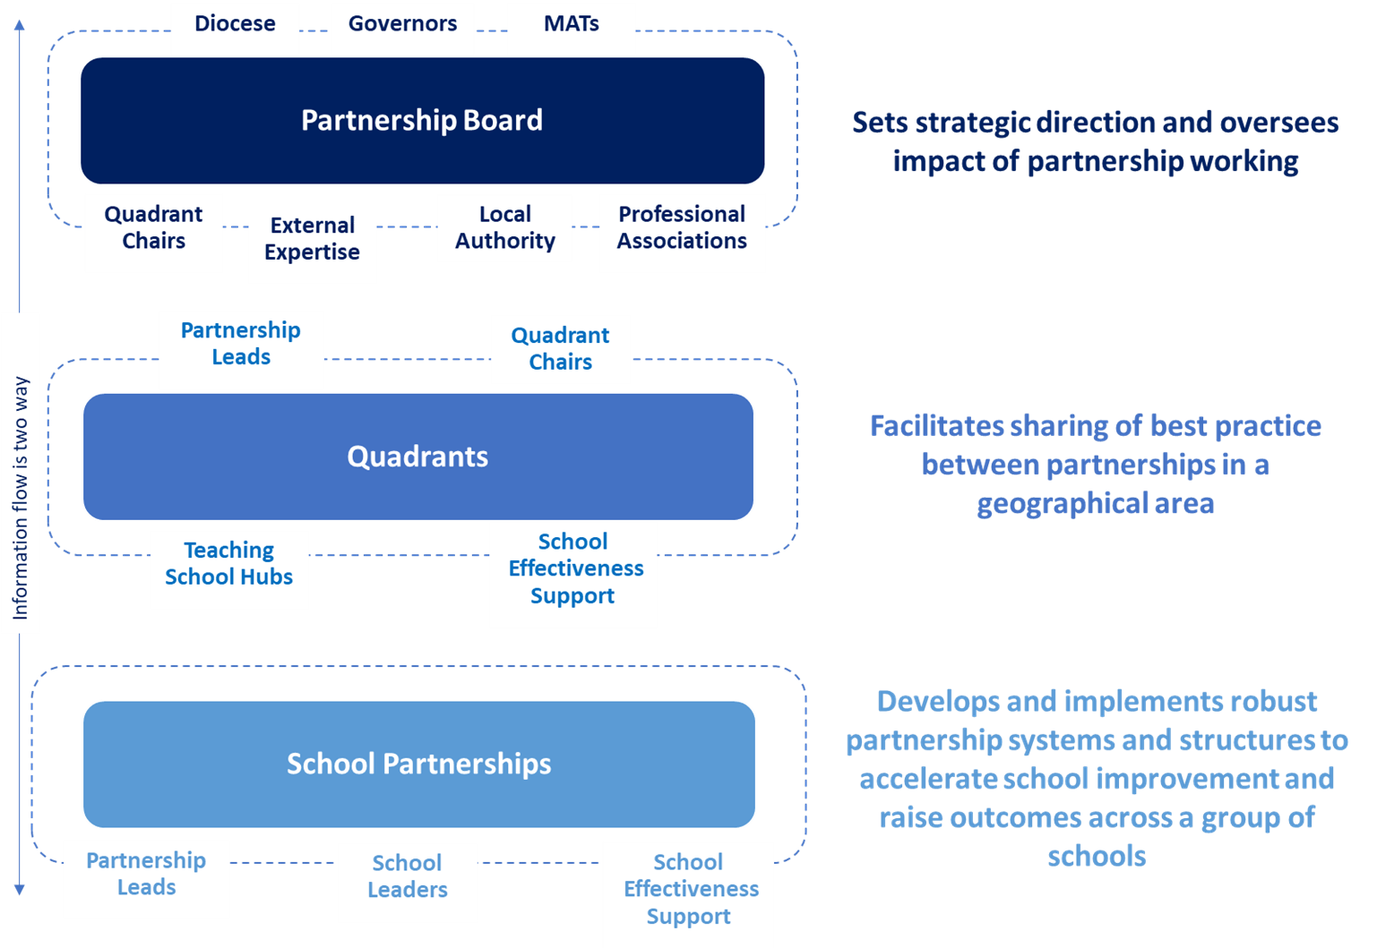
Essex Partnership System
Notes:
Essex Partnership System
We are engaging with Quadrant chairs to support the quadrant meetings being helpful, meaningful to partnership leads and a good use of time
Teaching school/Curriculum hubs will also be involved and keen to join up

Slide 44
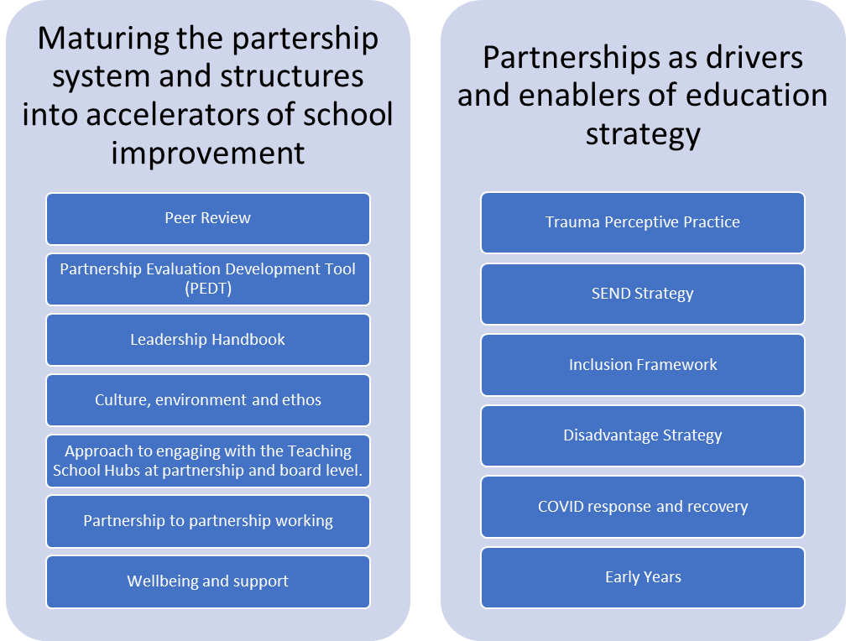
Aims of the Strategy
Notes:
Aims of the strategy - Talk through - emphasise partnerships enablers of strategy
Tools to help support the growing maturity and sustainability of partnerships
If new leads – have a partnership handbook – contact Nicola for latest version - updating Infolink website

Slide 45
Partnership Evaluation and Development Tool
Aims of the Tool:
To enable partnerships to evaluate their collaboration
To help establish a dialogue and way of working that builds challenge, support and trust
To generate useful information that helps partnerships make best use of their resources and guides improvement
For the tool to be intuitive, flexible and easy to use

Slide 46
The School Partnership Board has agreed a series of actions to achieve the broader outcomes of the new Essex Partnership Strategy:
Set a clear Strategic Direction for partnership working in Essex
Agree an annual set of priorities, which is informed by the work of the partnerships and quadrants and agreed by the board as county priorities
Strengthen the focus on cross-phase working
Enable partnerships to share best practice
Enable partnerships to evaluate their impact, through models such as peer review
Clarify the partnership system, the roles and responsibilities of each part and the resources available to support partnerships e.g., co-ordination and facilitation
Review the membership and representation of the Board
Take an active role in the promotion of partnership working
Support development of focus groups to take forward specific actions and feedback to the board
Continue development of tools and support for partnerships around school improvement
  Peer review
  Partnership evaluation development tool
  Leadership handbook

Slide 47
Assessment and Moderation
Alison Fiala, Head of Education and Early Years

Slide 48
Primary Statutory Assessment Traded Package
Aim is to support schools to carry out primary assessments in summer 2022
It includes a full programme of training covering all aspects of KS1 and KS2 assessment and moderation, administration of the phonic screening check and the multiplication tables check
The package is for an annual subscription that allows up to 2 members of staff to attend 10 training sessions held throughout the year
Schools not wishing to have the annual subscription can attend individual events
All training sessions will be for one hour and will be held virtually
Notes:
The Standards and Testing Agency (STA) are planning for a full programme of primary assessments to take place in the 2021/22 academic year. This will include the introduction of the statutory multiplication tables check for year 4 pupils.
To support schools to carry out primary assessments in summer 2022 the Local Authority is offering a full programme of training that will cover Key Stage 1 and Key Stage 2 assessment and moderation, the administration of the phonic screening check and the multiplication tables check.

Slide 49
Primary Statutory Assessment Traded Package
The training sessions are:
Termly Primary Statutory Assessment Briefings (Autumn 2, Spring 2 and Summer 1)
Administering the phonic screening check
Managing the statutory assessment process for KS1 and KS2
Administering the multiplication tables check
Understanding the KS1 Teacher Assessment Framework
Understanding the KS2 Teacher Assessment Framework
Assessment and moderation in Year 2 refresher course
Assessment and moderation in Year 6 refresher course

Slide 50
Primary Statutory Assessment Traded Package
 | Annual subscription for Sep 2021/22 | Individual training events for non-subscribers
Essex LA maintained schools | £315 | £55 per session for 2 members of staff
Essex Academies | £395 | £65 per session for 2 members of staff
Outside Essex Schools and academies | £495 | £75 per session for 2 members of staff
Notes:
Costs are in the table. Stress that for LA maintained schools each session works out at just over £30 and for academies just under £40 for 2 people to attend.
Subscription fees are non-refundable however if the proposed statutory assessment process for 2021/22 is withdrawn by the government, the LA would refund the costs for the remaining subscription period or carry it forward at these prices for the following academic year.
Schools and academies will be invoiced following their request to sign up to the package.

Slide 51
Primary Statutory Assessment Traded Package
The following training events are offered:
Assessment and moderation in Year 2 – new teachers in year 2 and NQTs
Assessment and moderation in Year 2 – experienced year 2 teachers
Assessment and moderation in Year 6 – new teachers in year 6 and NQTs
Assessment and moderation in Year 6 – experienced year 6 teachers
Subscribers from Essex LA maintained schools and academies | £40 first member of staff £10 each additional person
Non-subscribers from Essex LA maintained schools and academies | £60 first member of staff £15 each additional person
Subscribers from schools and academies not in Essex LA | £50 first member of staff £20 each additional person
Non-subscribers from schools and academies not in Essex LA | £70 first member of staff £25 each additional person
Notes:
These training events will run in the spring term. Each one will be for up to 3 hours to allow time to cover all the aspect of assessment and moderation in depth.
All schools can attend these training events but if schools have signed up to the package they can attend at a reduced rate. Costs are in the table on the slide.
If schools are interested in the whole package or just aspects of the training they should contact Workforce Development or follow the link on the end of key stage statutory assessment page on Essex Schools Infolink

Slide 52
Wishing you all continued success for 2021-2022.
“Excellence, Equity, Inclusion.”

