Slide 2
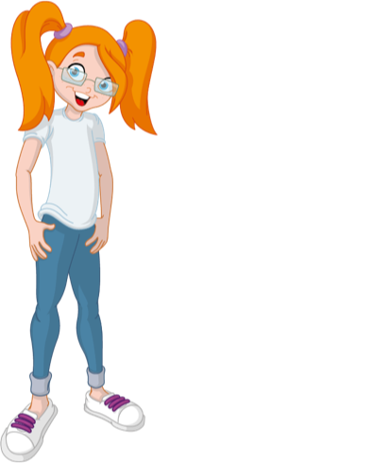
Meet Dorothy Com.. or Dot Com to her friends
“Giving children skills to manage their own well being and safety”

Slide 3
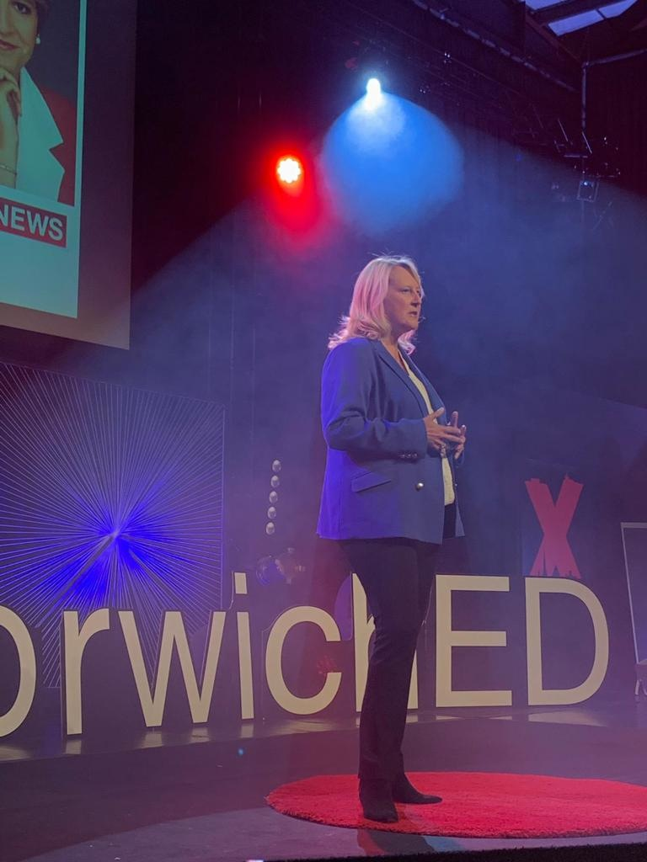
Based on a true story

Slide 4
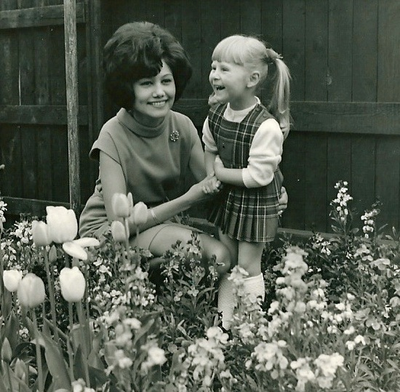

Slide 5
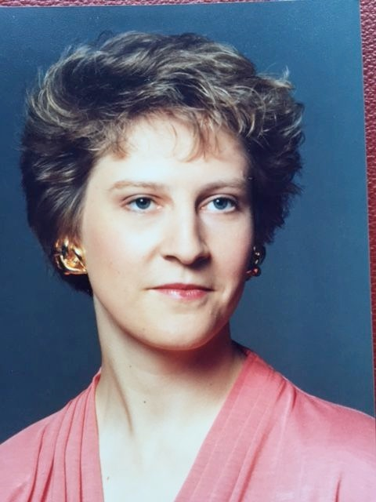
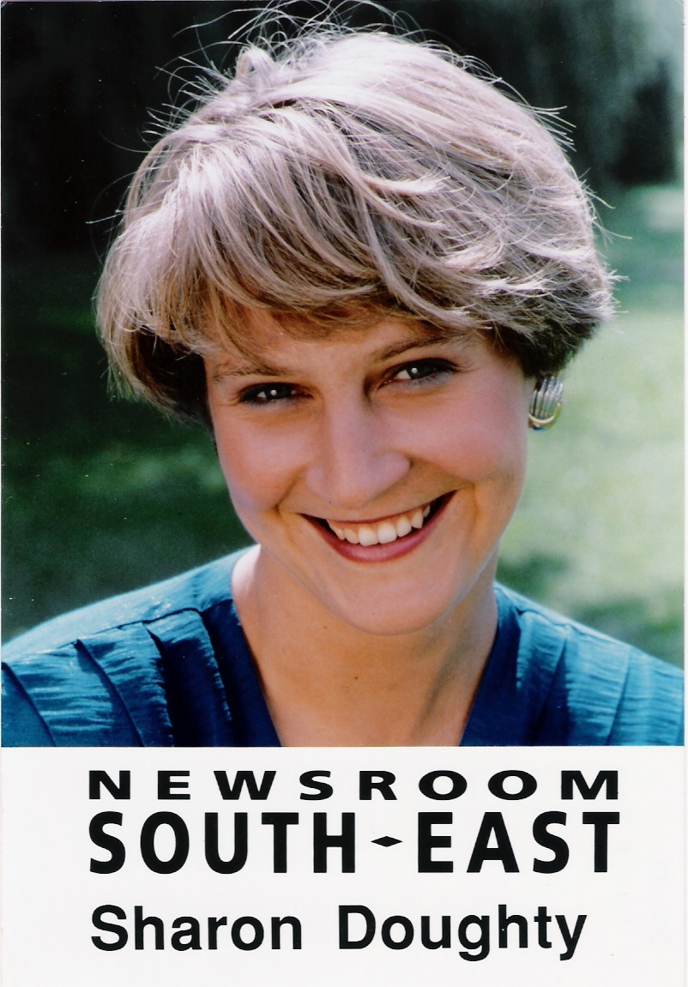
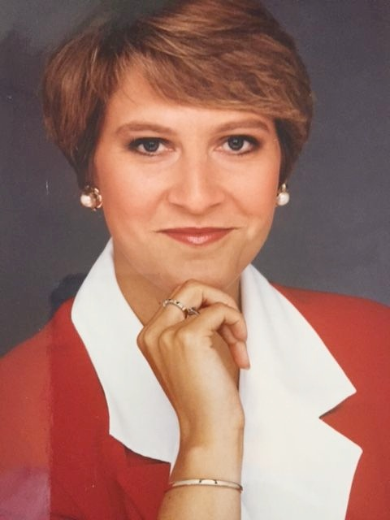

Slide 6
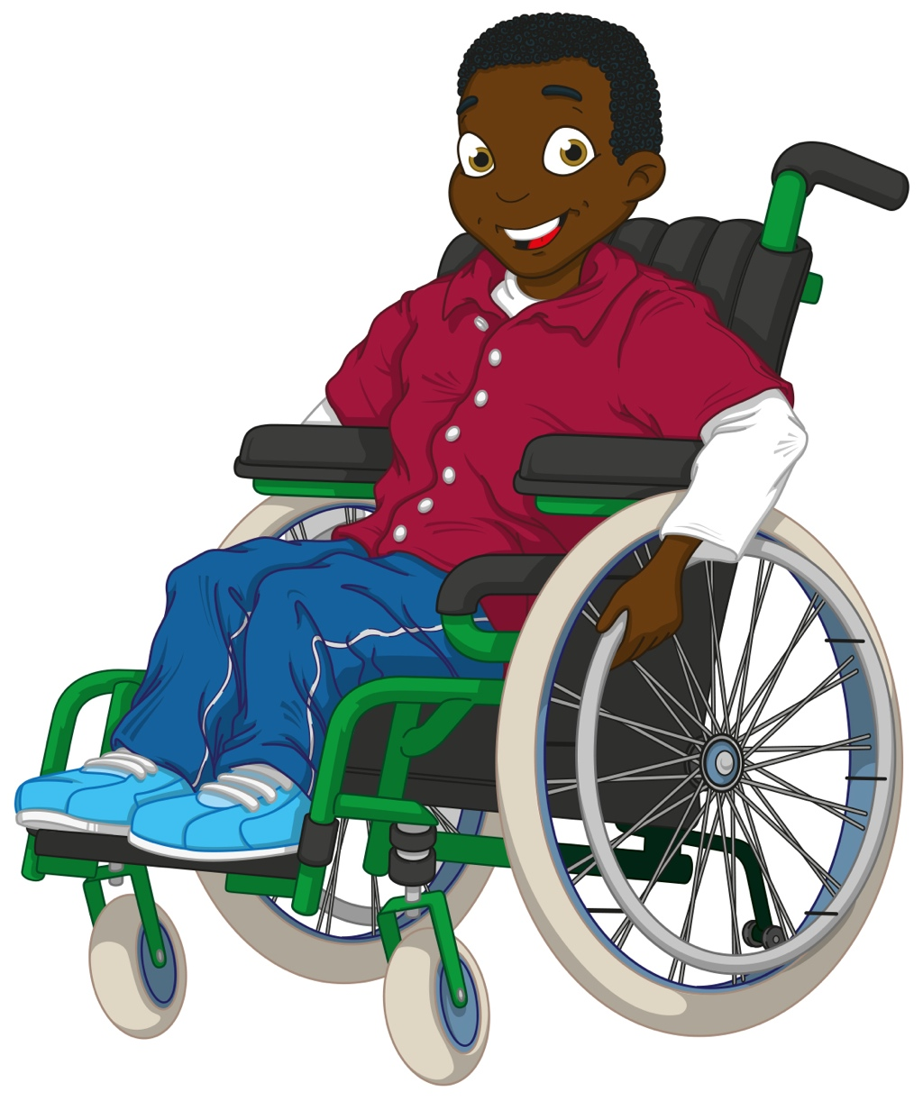
Dot Com communicates with children in their own language and helps develop an emotional vocabulary
The Dot Journals are a communication tool

Slide 7
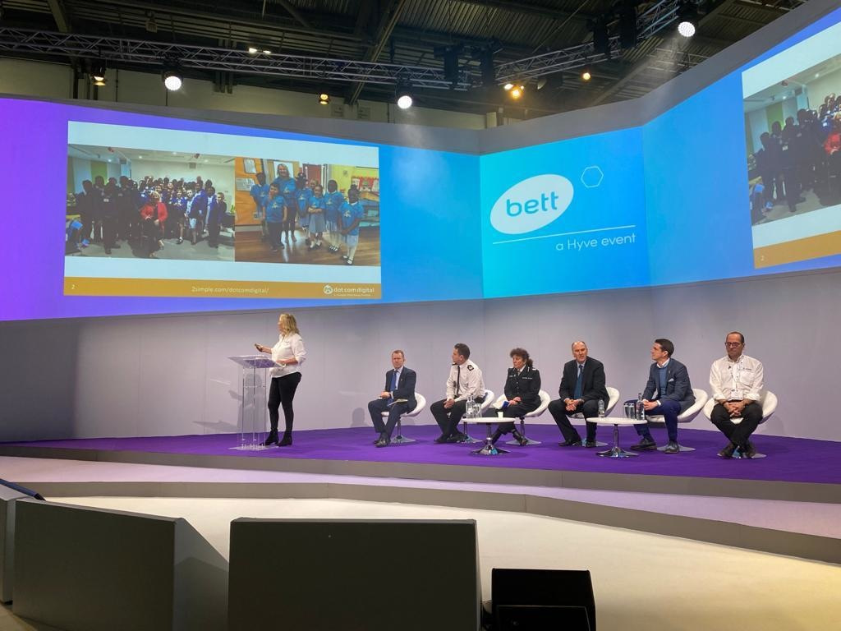

Slide 8
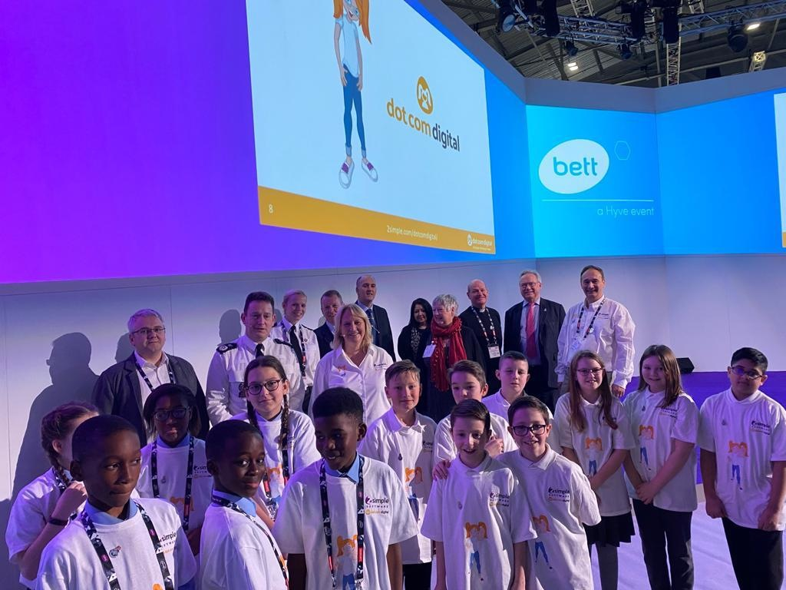

Slide 9
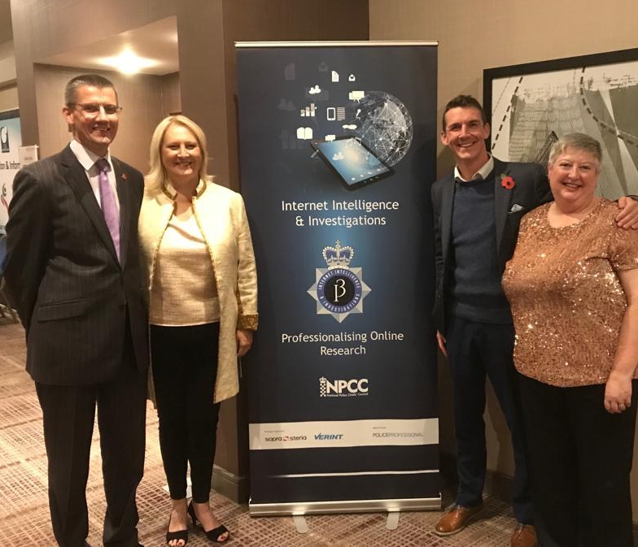
Partnership

Slide 10
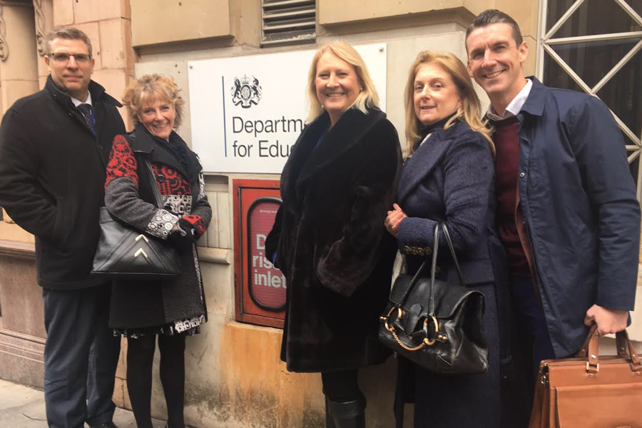
Department for Education

Slide 11
DFE
DotCom Digital - a free resource for schools, created by children with Essex Police and the National Police Chief Council Lead for Internet Intelligence and Investigations.
The resource aims to prevent young people becoming victims of online grooming, radicalisation, exploitation and bullying by giving them the confidence to recognise warning signs and reach out to an adult for help.

Slide 12
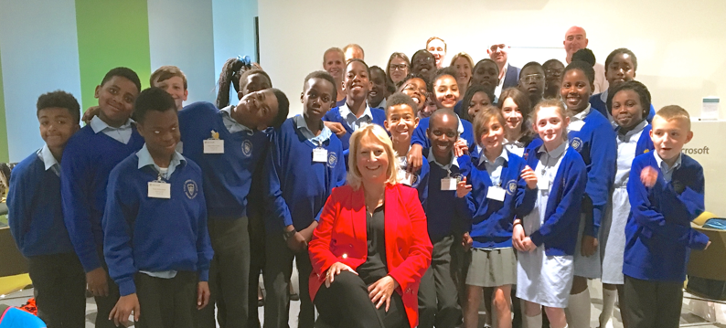
Dot Com Digital Journal
Created by ‘children for children’

Slide 13
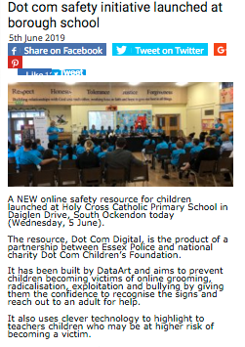
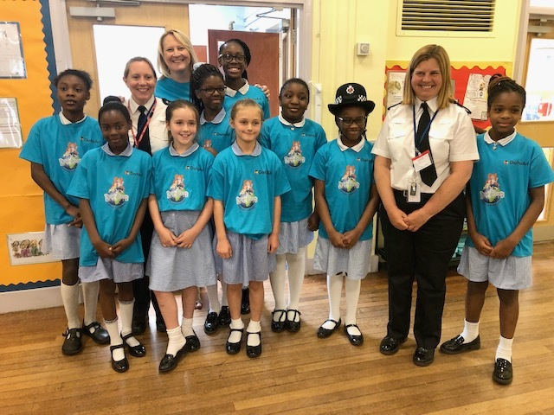
ESSEX: Dot Com safety initiative launched at borough school
5th June 2019 Holy Cross Catholic Primary School, Essex.

Slide 14
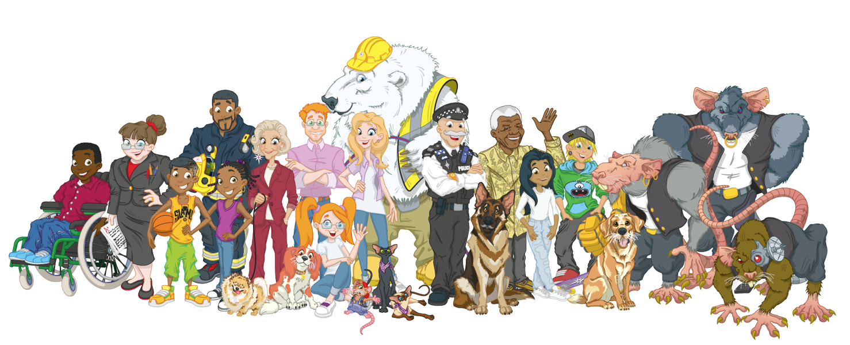
Character Based Learning

Slide 16
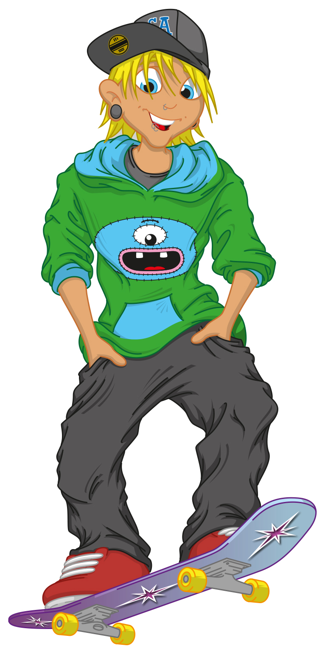
'Feelings are just feelings' there are no good or bad feelings.
STOP FEEL THINK DO
Behaviour is a choice with an effect and consequence or reward.Nobody makes us do
We choose to respond

Slide 18
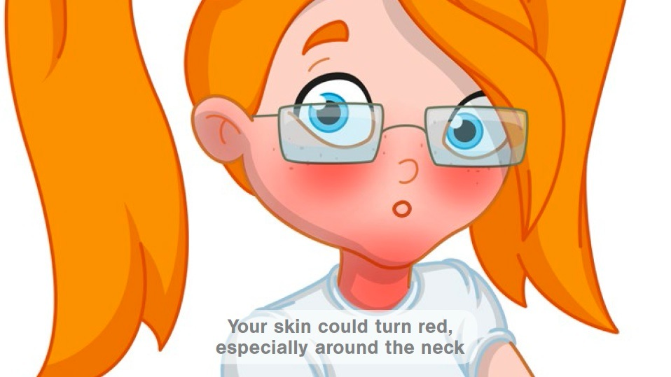
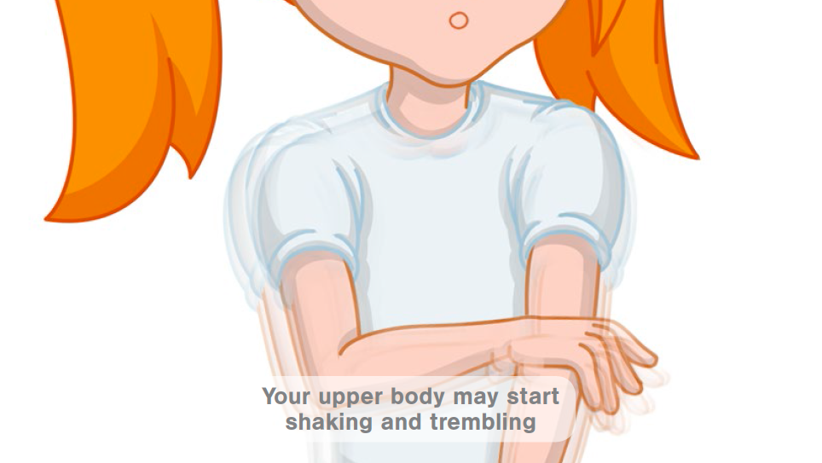
Dot Com Uh-oh signs
We can talk with someone about anything, even if it feels awful or small.

Slide 19
Risking on purpose
Someone might feel their uh-oh signs when a situation is taking them out of their comfort zone.
Someone might choose to risk on purpose for example
Getting on a roller coaster
Running in a race
Doing a presentation

Slide 20
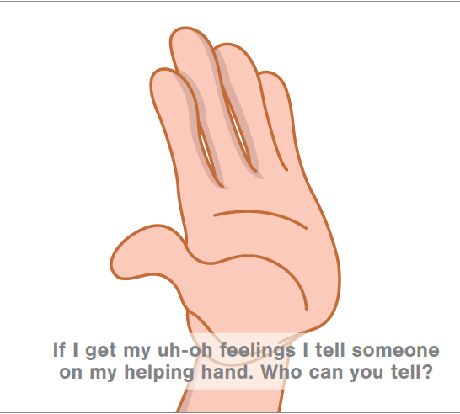
Helping hand
Helps children identify who is there in the community to help us when we are not feeling safe.

Slide 21
Dot Com Minute
We can talk with someone about anything, even if it feels awful or small.

Slide 22
Treat others as you would like to be treated.....
Doing the right thing is hard
Courage is not the absence of fear
Nanny Com’s Golden Rules

Slide 23
