Slide 1
ECC AND ESSET OUTREACH UPDATE

Slide 2
PROGRESS UPDATE:
* FORMAL ESSET OFFER SHARED WITH LA OCTOBER 2023
* FUNDING AGREED BY LA/SCHOOL FORUM
* ESSET PRESENTATION TO LA LEADERS IN EARLY DECEMBER 2023
* OUTREACH OFFER BEING PILOTED IN NORTH EAST QUADRANT
* OUTREACH INCLUDED IN SEND SUFFICIENCY PLAN- JANUARY 2024

Slide 3
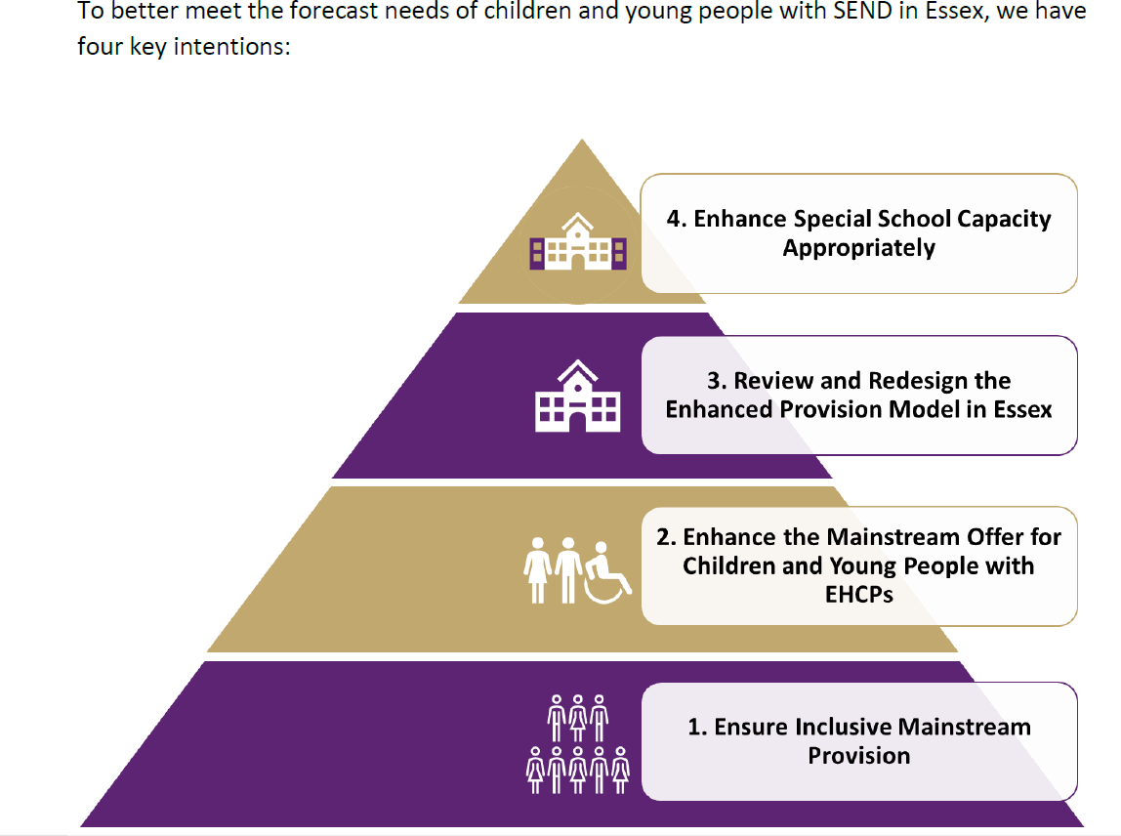
SEND SUFFICIENCY:

Slide 4
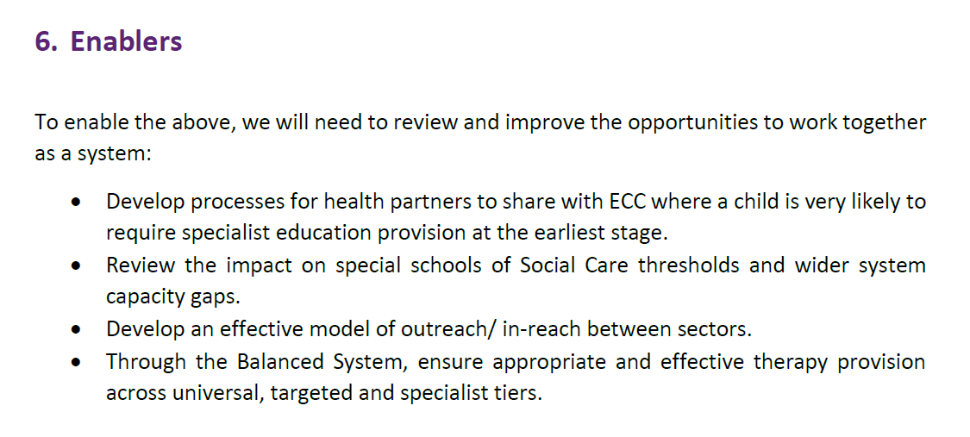
SEND SUFFICIENCY:

Slide 5
PROGRESS UPDATE:
* DRAFT PROCESS DOCUMENTS, SLA’S ETC DESIGNED BY ESSET. DRAFT QA DOCUMENTS AND IMPACT CRITERIA ALSO DEVELOPED.
* LAST PRESENTED TO EPHA EXECUTIVE IN JANUARY 2024
* ESSET/LA WORKING GROUP MEETING ON 1 MARCH 2024 (THIS FRIDAY)

Slide 6
CHALLENGES:
*CONCERNS ABOUT LENGTH OF TIME TAKEN TO ROLL-OUT OUTREACH PLAN
* NUMBER OF OTHER PRIORITIES/WORK STREAMS IMPACT ON PROGRESS
* NO CLEAR PROCESS FOR FUNDING TO BE TRANSFERRED TO ESSET SCHOOLS TO ENABLE WIDER ROLL-OUT OF OUTREACH WORK
* NUMBERS OF PEOPLE NEEDING TO BE INVOLVED LEADING TO DELAYS
* INCONSISTENT ROLL-OUT OF SPECIAL SCHOOL ADMISSION PANEL
* ONGOING CHALLENGING CIRCUMSTANCES (STAFFING ETC) IN INDIVIDUAL SPECIAL SCHOOLS

Slide 7
ACTIONS:
*EW AND RH MET TO DISCUSS CONCERNS ON 23 JANUARY 2024 TO AGREE NEXT STEPS AND NEED FOR CLEAR TIMELINE
* FOLLOW UP EMAIL- CONCERNS RE: TIMELINES RAISED AT LA SLT MEETING W/C 5 FEBRUARY 2024
* RESCHEDULED MEETING TAKING PLACE WITH RH, STRATEGIC LEADS AND QM’S ON 1 MARCH 2024
* INDIVIDUAL MEETINGS TAKING PLACE IN MARCH WITH LA REPS FROM ALL 4 QUADRANTS TO ARRANGE ROLL-OUT IN EACH QUADRANT
* FOLLOW UP RE: ROLL-OUT OF SPECIAL SCHOOL ADMISSION PANEL- NOW ROLLED OUT IN ¾ QUADRANTS
* JOB DESCRIPTIONS AND PERSON SPECIFICATIONS DRAFTED

Slide 8
NEXT STEPS:
* MEETING BETWEEN ESSET AND LA WORKING GROUP MEMBERS ON 1 MARCH 2024 (FRIDAY)
* JOB ADVERTS TO BE AGREED BY ECC AND GO LIVE
* MEETINGS WITH ALL 4 QUADRANT REPS TO AGREE ROLL-OUT PROCESS AND TIMELINE IN THEIR INDIVIDUAL AREAS- MARCH 2024
* MEETING WITH EPHA WORKING GROUP REPS TO FINALISE QA DOCUMENTS AND IMPACT CRITERIA
* COUNTY- WIDE ROLL-OUT

