Slide 1
Let’s Talk… A common language and understanding of emotional wellbeing and mental health
SEMH Strategy Team
A joined-up approach between services to support the emotional wellbeing and mental health of children and young people

Slide 2









A joined up approach between services
This new guidance has come out of the work of the Emotional Wellbeing & Mental Health Strategic Board, which includes a range of partners.

Slide 3
Introduction
The purpose of this new guidance document is to provide a shared understanding of emotional wellbeing and mental health so that children and young people (CYP), families, schools/settings and service providers use a common language, are understood and can plan for consistent and equitable support.
It is for anyone in Essex, Southend & Thurrock who works with or supports CYP, with a particular focus on emotional wellbeing and mental health. This includes schools/settings, health services and care providers, but it may also be useful for others who provide support as well as parents/carers.
Alternative versions aimed at families and children/young people are currently in development.
All versions are being launched in the Spring term.

Slide 4
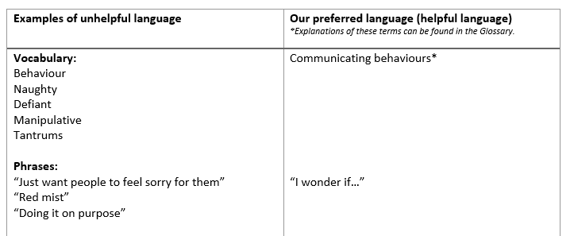
Helpful & Unhelpful Language
Unfortunately, there continues to be inconsistencies and unclear approaches across the systems and CYP, families and professionals report experiencing or hearing a range of derogatory and unhelpful terms/phrases which are experienced as judgemental and maintain the stigma around mental health. This has got to change.
We include a table to illustrate how some of the unhelpful language we may currently hear can be adapted to promote compassion and kindness, hope, connection and belonging.

Slide 5
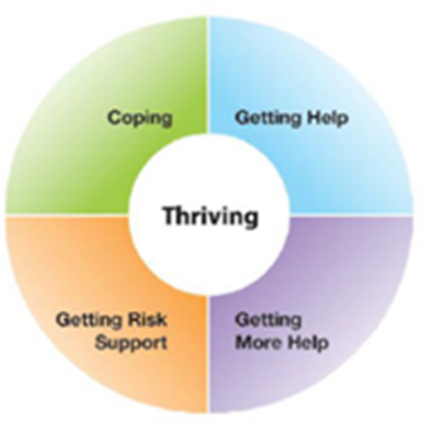
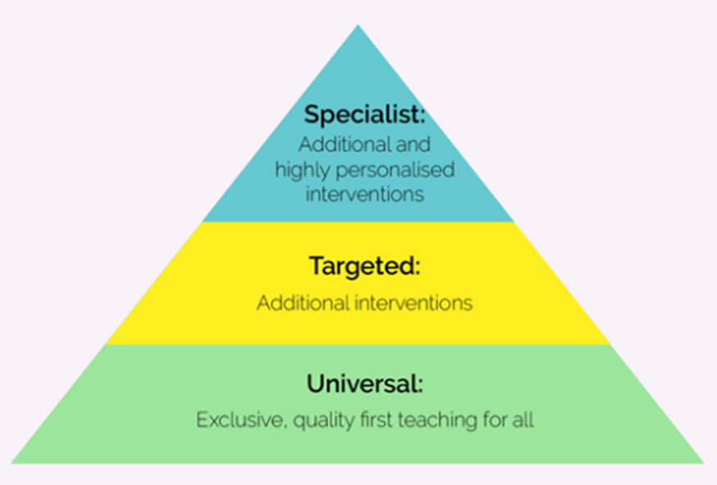
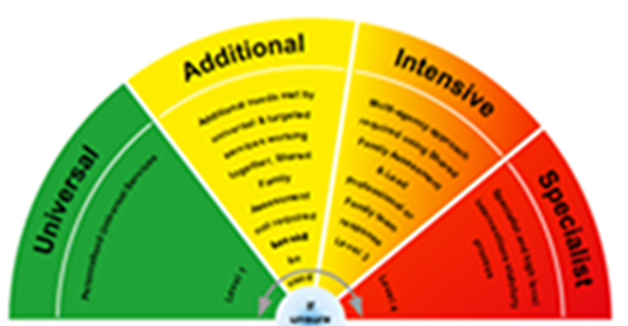
Understanding levels of intervention across Education, Health and Care

Slide 6
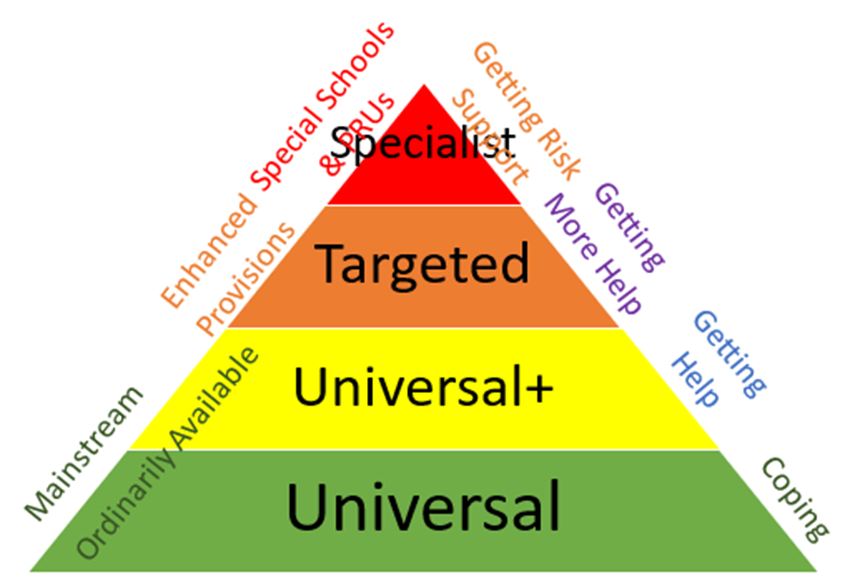

Slide 7
Risk & Protective Factors
Risk and protective factors are environmental influences on a CYP’s wellbeing. They are important to consider as they explore the barriers and support mechanisms that are available to them at the time of assessment/review.
By using this approach, our assessments are more holistic and moves us away from a ‘within child’ model, placing more of a focus on the support that needs to be made available to them and what will make the greatest amount of difference for them.
Exploring risk and protective factors sensitively with families can enable increased knowledge and understanding of how more protective factors can be provided within different contexts e.g. school, home and community, providing families with the autonomy and empowerment to explore further changes that could be made.

Slide 8
Theme | Examples of Risk factors | Examples of Protective factors
CYP | Genetic influences Learning disabilities Communication difficulties Physical illness Low self-esteem Feelings of isolation | Secure attachment(s) experience Outgoing temperament Good communication skills Humour Confident Faith or spirituality
Family | Family breakdown Inconsistent or unclear boundaries and limitations Hostile / rejecting relationships Parental or sibling illness | At least one good attachment Affection Clear, consistent discipline Support for education Protection from harm and fear Adequate socioeconomic resources
School/ setting | Bullying / abuse Discrimination Peer influences towards risk taking Fragile pupil to teacher/school staff relationships Experience of school ‘failures’ | Inclusive practice Clear policies on behaviour and bullying A whole-school approach to promoting good mental health Good pupil to teacher/school staff relationships
Community | Socio-economic disadvantage Homelessness Disaster, accidents, war or other overwhelming events Presence of neighbourhood crime Negative Social Media | Wider supportive network Good/stable housing Opportunities for valued social roles Range of sport/leisure activities available Steady employment Availability of services (social, recreational, cultural, etc) Access to Technology

Slide 9
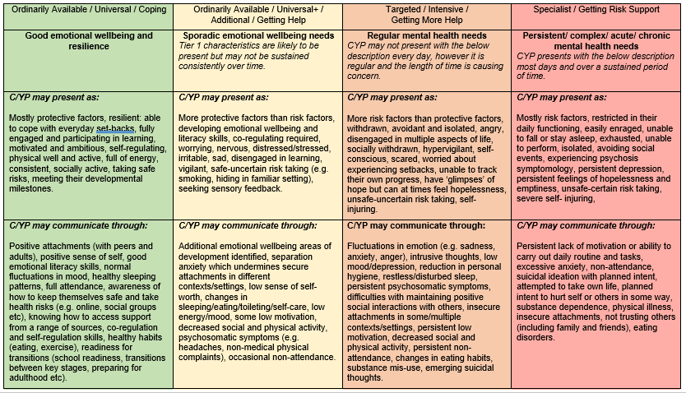
What EWMH looks like at different levels of need

Slide 10
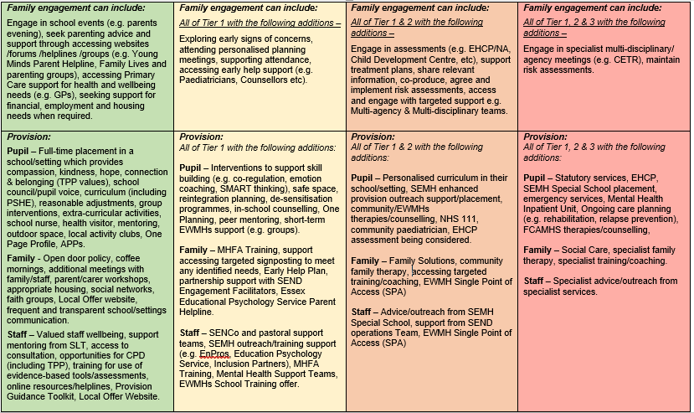

Slide 11
Resources
Directories for accessing support
Glossary & Acronyms
Acknowledgements:
  This guidance is created with the support of the Emotional Wellbeing & Mental Health Strategic Board, including members from Essex County Council, Southend Borough Council, Thurrock Council, Essex Safeguarding Children’s Board, Essex Public Health, NELFT, EWMHS, Essex Child and Family Wellbeing Service, Essex Primary Heads Association, Association of Secondary Heads in Essex and Essex Special School Education Trust.
  Additional thanks to all the CYP and parents who have contributing to our research from the Essex Family Forum, EWMHS Participation Group, Multi-schools Council, Health Watch Mental Health Youth Ambassadors and the SEND Inclusion & Psychology Teams.
References

