Slide 1
Andrew Moffat MBE Personal Development Lead, Excelsior Trust, Birmingham
www.nooutsiders.com
@Moffat_Andrew

Slide 2
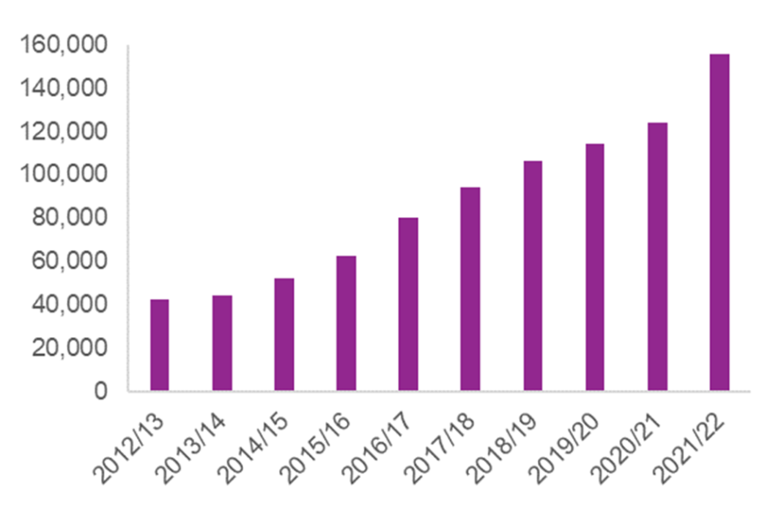
Why are we here?
Hate crime, England and Wales, 2021-2022
In year ending March 2022, there were 155,841 hate crimes recorded by the police in England and Wales, a 26 per cent increase compared with the previous year.
The majority of hate crimes were racially motivated, accounting for 70% of such offences;

Slide 3
Schools: an alternative narrative
“We have to be delivering a curriculum that enables children to understand the benefits that exist in a society where diversity and difference are celebrated. Furthermore we need our children to want to be part of that society, and we have to sell it to them; that desire may not come naturally by itself.”

Slide 4
The Equality Act 2010
Public bodies have to consider all individuals when carrying out their day to day work- in shaping policy, in delivering services and in relation to their own employees.
It also requires that public bodies
Have due regard to the need to eliminate discrimination
Advance equality of opportunity
Foster good relations between different people when carrying our their activities
(Government Equalities Office, 2013, p13)

Slide 5
What’s it like living in the UK today?
What messages are we giving our children about…..
Race
Religion
Sex (Gender)
Gender reassignment
Age
Disability
Sexual orientation
Pregnancy or maternity
Marriage or civil partnership

Slide 6
KCSIE 2022 (p49)
Children who are lesbian, gay, bi, or trans (LGBT)
202. The fact that a child or a young person may be LGBT is not in itself an inherent risk factor for harm. However, children who are LGBT can be targeted by other children. In some cases, a child who is perceived by other children to be LGBT (whether they are or not) can be just as vulnerable as children who identify as LGBT.
203. Risks can be compounded where children who are LGBT lack a trusted adult with whom they can be open. It is therefore vital that staff endeavour to reduce the additional barriers faced, and provide a safe space for them to speak out or share their concerns with members of staff.
204. LGBT inclusion is part of the statutory Relationships Education, Relationship and Sex Education and Health Education curriculum and there is a range of support available to help schools counter homophobic, biphobic and transphobic bullying and abuse.

Slide 7
Ofsted guidance 2022 (Personal Development)
Para 293
develops pupils to become responsible, respectful and active citizens who are able to play their part and become actively involved in public life as adults
through the curriculum, assemblies, wider opportunities, visits, discussions and literature, develops and deepens pupils’ understanding of the fundamental British values of democracy, individual liberty, the rule of law, and mutual respect and tolerance
promotes equality of opportunity so that all pupils can thrive together, understanding that difference is a positive, not a negative, and that individual characteristics make people unique. This includes, but is not limited to, pupils’ understanding of the protected characteristics and how equality and diversity are promoted
develops pupils’ age-appropriate understanding of healthy relationships through appropriate relationships and sex education

Slide 8
RSE: Equality
Para 31. Schools should be alive to issues such as everyday sexism, misogyny, homophobia and gender stereotypes and take positive action to build a culture where these are not tolerated, and any occurrences are identified and tackled. Staff have an important role to play in modelling positive behaviours. School pastoral and behaviour policies should support all pupils.

Slide 9
Ofsted: Parkfield Community School (May 2016)
The provision for pupils’ spiritual, moral, social and cultural development is a key strength of the school. Fundamental British values are actively promoted through the school’s work on ‘No outsiders in our school’, which develops pupils’ understanding of how the Equality Act relates to and affects them. As a result, pupils celebrate diversity and are respectful towards others, including those with different beliefs, sexuality, gender or culture. One pupil spoke for many when she told inspectors, ‘everyone is an insider in our school, there are no outsiders, whatever their beliefs, whatever their colour, gender or sexuality’.

Slide 10
After the 2019 No Outsiders protests: How is No Outsiders doing at Parkfield today?
No Outsiders resumed at Parkfield school September 2019
No further protests
Ofsted report November 25th 2022:
"What is it like to attend this school?
Pupils at Parkfield Community School say there are no outsiders here and that all are welcome. Leaders ensure that pupils understand their rights and pupils speak maturely about how they follow the values of being ‘ready, respectful and safe’. Pupils confidently discuss why they enjoy learning. They are very proud of their school."

Slide 11
Ofsted: Inspecting teaching of the protected characteristics (2022)
Pupils’ understanding of the protected characteristics and how equality and diversity are promoted form part of the evidence that inspectors use to evaluate the school’s personal development of pupils.
All primary and secondary schools, whether state-funded or independent, should be able to demonstrate that no form of discrimination is tolerated and that pupils show respect for those who share the protected characteristics.
Schools will not be able to demonstrate this by pointing to a general policy of encouraging respect for all people.

Slide 13
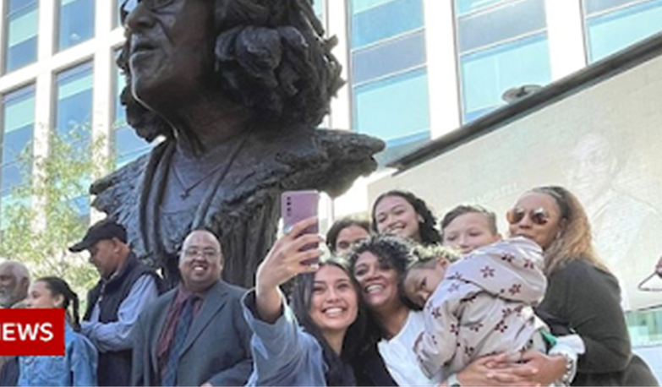
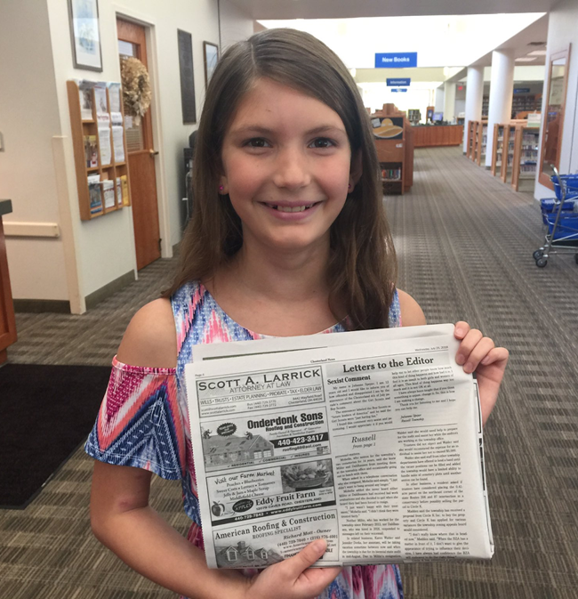
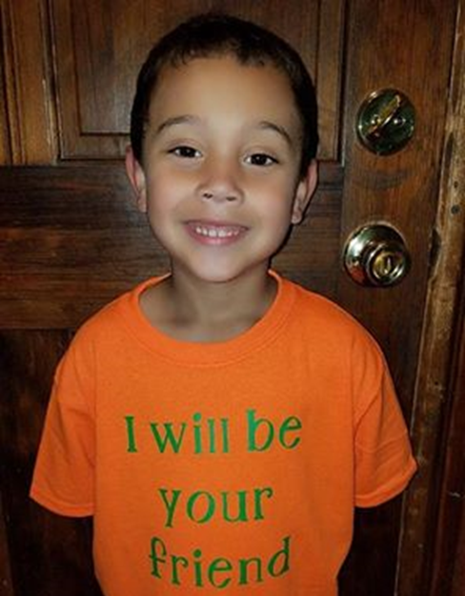
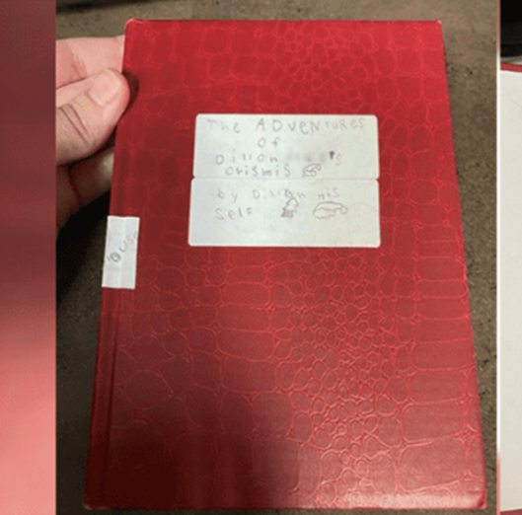
Assembly pictures develop the ethos

Slide 14
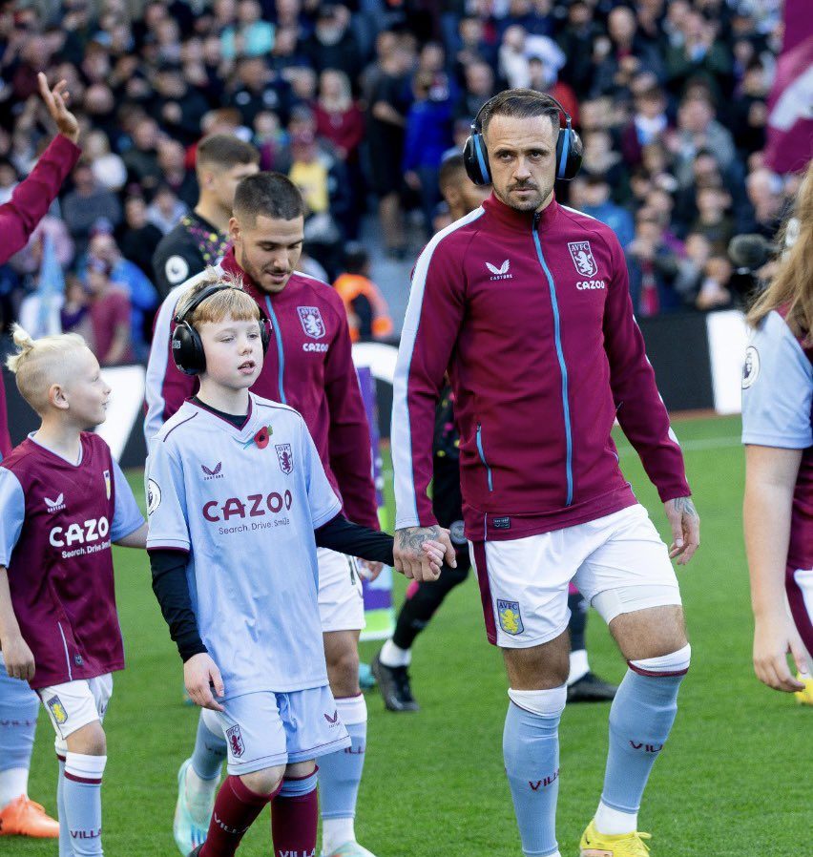

Slide 15
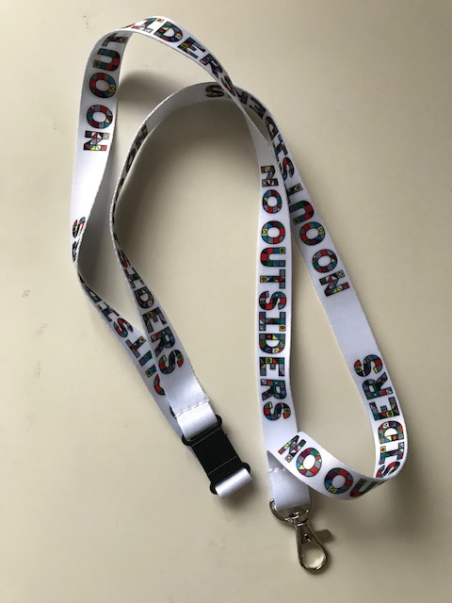
Thank you
www.no-outsiders.com
a.moffat@excelsiormat.org
@Moffat_Andrew

